Slide 1
Speech Emotion Classification Using Attention-Based LSTM
Nijat Mursali
Yunus Emre Darici

Slide 2
Overview
Introduction
Related Works
Development
Results
Conclusion

Slide 3
Introduction

Slide 4
Sequence prediction problems have been around for a long time. They are considered as one of the hardest problems to solve in the data science industry. These include a wide range of problems; from predicting sales to finding patterns in stock markets’ data, from understanding movie plots to recognizing your way of speech, from language translations to predicting your next word on your phone’s keyboard.
With the recent breakthroughs that have been happening in data science, it is found that for almost all of these sequence prediction problems, Long Short Term Memory networks(LSTMs) have been observed as the most effective solution.

Slide 5
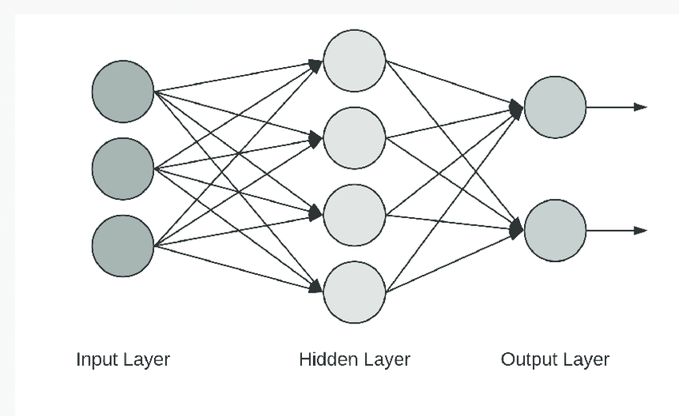
NEURAL NETWORK
Neural Networks are set of algorithms which closely resemble the human brain and are designed to recognize patterns. They interpret sensory data through a machine perception, labelling or clustering raw input. They can recognize numerical patterns, contained in vectors, into which all real-world data ( images, sound, text or time series), must be translated. Artificial neural networks are composed of a large number of highly interconnected processing elements (neuron) working together to solve a problem. Image classification,caracter recognition and forecasting are some of Neural Networks applications. RNN ,LSTM and GRU are most famous models for sequence learning.

Slide 6
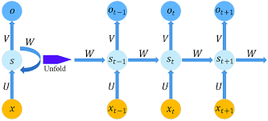
RNN
Recurrent Neural Network is a generalization of feedforward neural network that has an internal memory.
Unlike feedforward neural networks, RNNs can use their internal state (memory) to process sequences of inputs. This makes them applicable to tasks such as unsegmented, connected handwriting recognition or speech recognition. In other neural networks, all the inputs are independent of each other. But in RNN, all the inputs are related to each other. Although RNN is useful for short term memory learning ,it is weak for long term memory. For that reason such as LSTM and GRU models are needed to improved by time.
ht = f(ht - 1, xt)
ht = tanh(Whhht -1 + Wxhxt)
yt = Whyht

Slide 7
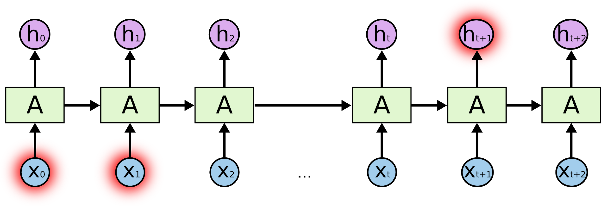

Slide 8
LSTMs
Long Short-Term Memory (LSTM) networks are a modified version of recurrent neural networks, which makes it easier to remember past data in memory. The vanishing gradient problem of RNN is resolved here. LSTM is well-suited to classify,process and predict time series given tme lags of unknown duration. It trains the model by using back-propagation.

Slide 9
Application of LSTMs
Text Prediction
Stock Prediction
Robot control
Time series prediction
Speech recognition
Rhythm learning
Music composition
Grammar learning
Handwriting recognition
Human action recognition

Slide 10
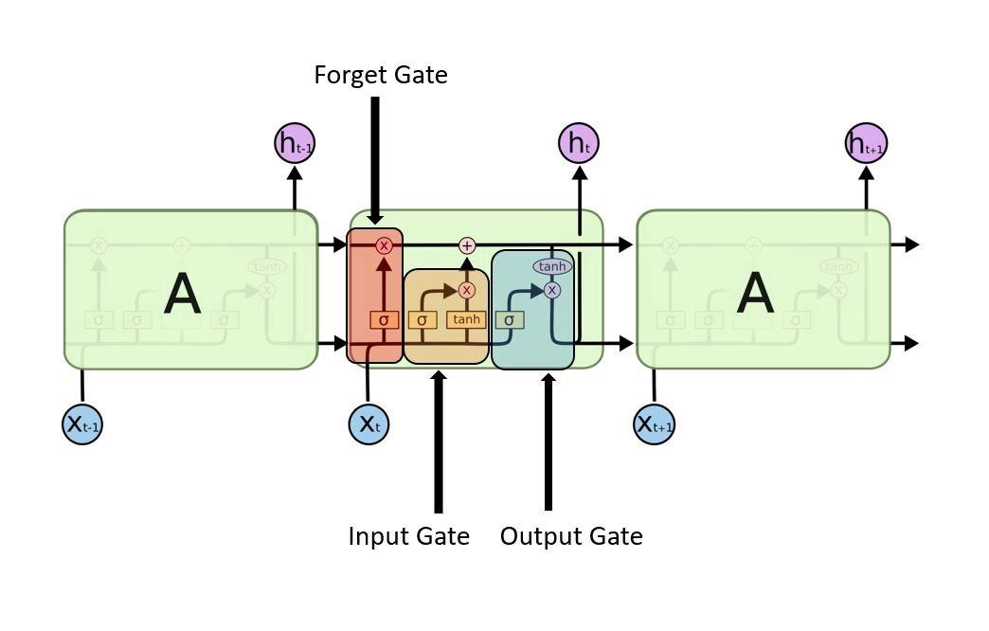
In an LSTM network,three gates are presented:
Input Gate
Forget Gate
Output Gate

Slide 11
INPUT GATE
Input gate — discover which value from input should be used to modify the memory. Sigmoid function decides which values to let through 0,1. and tanh function gives weightage to the values which are passed deciding their level of importance ranging from-1 to 1.
it= (Wi*[ht - 1, xt] + bi)
Ć = tanh(Wc*[ht - 1 , xt] + bc)

Slide 13
Forget Gate
Discover what details to be discarded from the block. It is decided by the sigmoid function. it looks at the previous state ht - 1 and the content input xt and outputs a number between 0(omit this)and 1(keep this)for each number in the cell state Ct - 1.
ft= (Wf*[ht - 1,xt] + bf)

Slide 15
Output Gate
The input and the memory of the block is used to decide the output. Sigmoid function decides which values to let through 0,1. and tanh function gives weightage to the values which are passed deciding their level of importance ranging from-1 to 1 and multiplied with output of Sigmoid.
ot= (Wo*[ht - 1,xt] + bo)
ht = ot * tanh(Ct)

Slide 16
Cell State
Acts as a highway that transports relative information along the sequence chain. Next, the cell state is calculated. First, the cell state is multiplied by f(result of step 1) which is then added to i(result of step 2), resulting in the new cell state(c).
Cf=ft*Ct-1 + it*Ćt

Slide 17
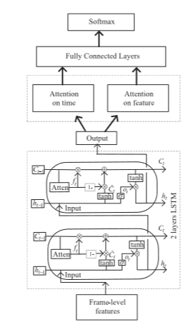
Attention Gate
The forgetting gate of the LSTM cell is used to determine what information should be discarded in the cell state at the previous moment and participate directly in updating the cell state. In the original LSTM proposed by Hochreiter, the update algorithm of the cell state is related to the hidden layer output at the previous moment and the input at the current moment. Furthermore, they added a peephole connection and took the cell state of the previous moment as a parameter to update the current state.

Slide 18
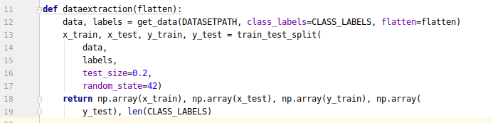
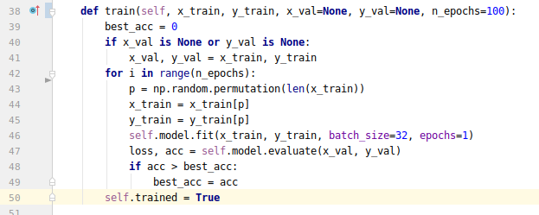
Development
Getting the SAVEE Dataset
CASIA? No.
recorded from four native English male speakers
7 emotion categories by different speakers
Loading the dataset into the memory
Training the dataset and making data extraction
Predicting the users speech online

Slide 19
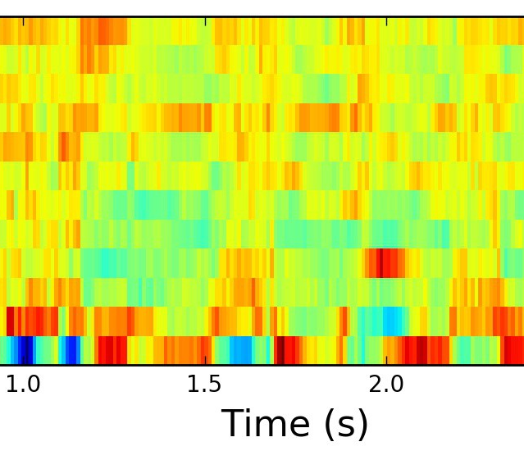
Development (cont.)
4. the mel-frequency cepstrum (MFC)
a representation of the long-term power spectrum of a sound, based on a linear cosine transform of a log power spectrum on a nonlinear mel scale of frequency.
Mel-frequency cepstral coefficients (MFCCs) are coefficients that collectively make up an MFC.

Slide 20
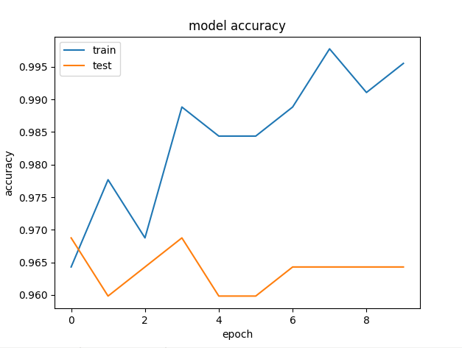
Results
Checking the accuracy of algorithm
Accuracy more than 90% for test dataset
Loss of 0.12 for the test dataset
Checking the confusion matrix

Slide 21
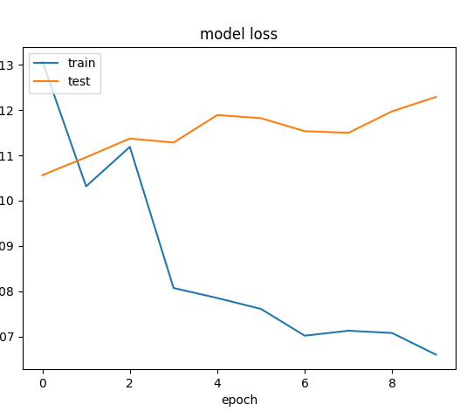
Results

Slide 22
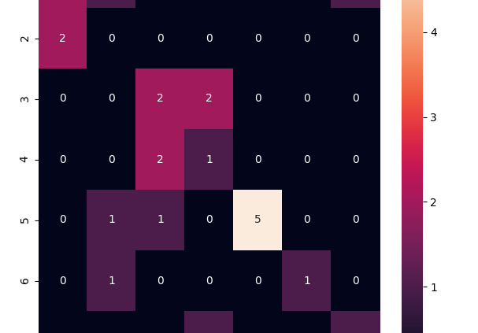
Conclusion
Getting high accuracy and low loss
Future plans?
Try to develop algorithm with bigger datasets

